Slide 1
Remote Working End User Guide
A step by step guide for practices wanting
to enable remote working

Slide 2
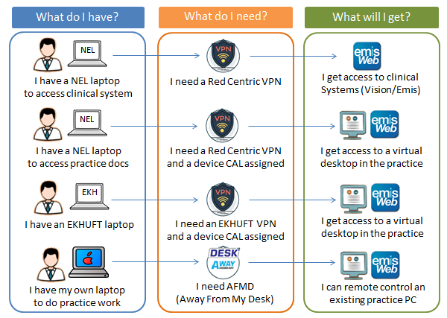
Remote working roadmap

Slide 3
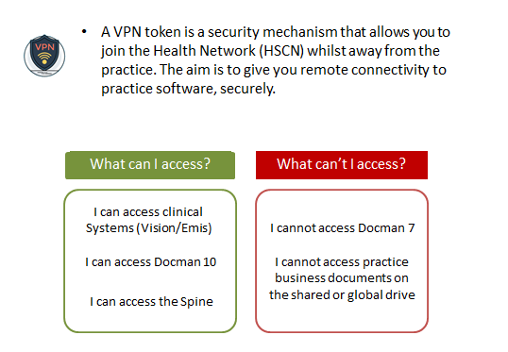
What is a VPN Token?

Slide 4
What is RDS?

Slide 5
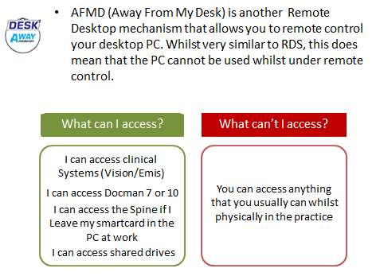
What is AFMD?

Slide 6
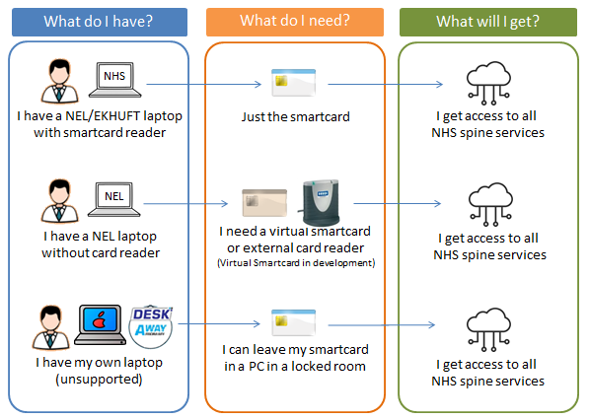
Spine Services (EPS) roadmap

Slide 7
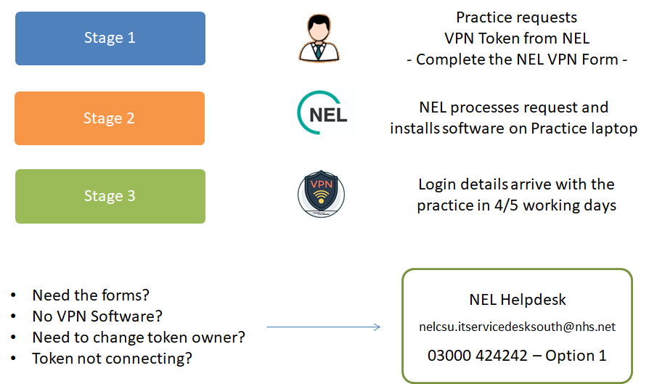
VPN token (Red Centric) - Request Process

Slide 8
RDS - Request Process

Slide 9
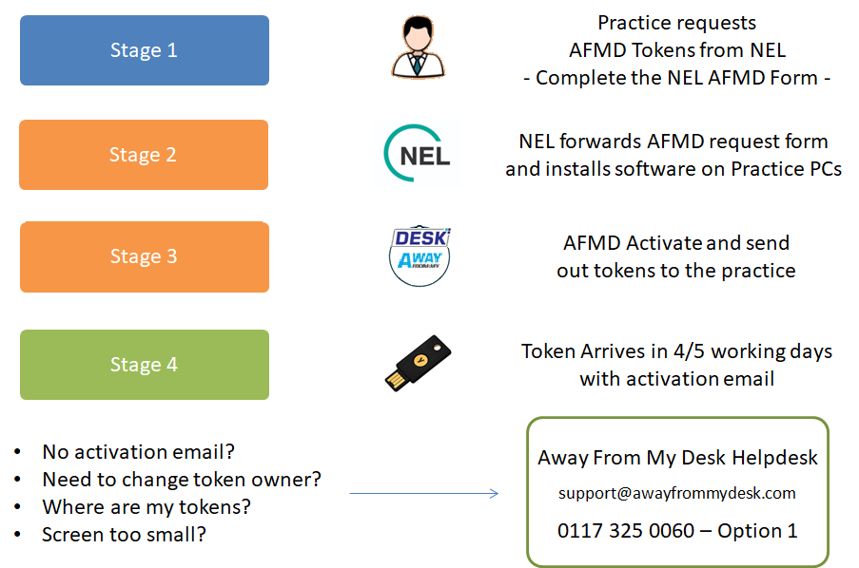
Away From My Desk - Request Process

Slide 10
Glossary of terms
VPN – Virtual Private Network
A token to connect you to the health network via the internet
CAL – Client Access Licence
A licence to allow you to connect to the practice server and establish a virtual desktop session (NEL provide this licence automatically, no request necessary)
AFMD – Away From My Desk
Software that gives you secure ‘remote control’ access to your surgery PC
RDP – Remote Desktop Protocol
Software that gives you a ‘virtual desktop’ and doesn’t use a surgery PC
NEL (CSU) – North East London Commissioning Support Unit
Our Main IT support supplier
EKHUFT – East Kent Hospitals University Foundation Trust
The East Kent hospital trust. They provided an amount of laptops in East Kent for use by GP practices.
EMIS / VISION – Egton Medical Information Systems / In Practice Systems Vision
The Principal clinical systems in use across Kent and Medway
EPS – Electronic Prescribing Service
The Spine service that allows an electronic prescription to be sent to a patient nominated pharmacy
Spine Services – Electronic Health Services
Services such as Choose and Book, E-Referrals, Electronic Prescribing Service. Only available on the HSCN Health Network
HSCN – Health and Social Care Network
The Health Network. The NHS private network that allows the transmission of patient level data.

