Slide 1
General practice 2017/18
Chaand Nagpaul, chair GPC
Kent LMC

Slide 2
Overview
Response to challenges facing general practice
2017/18 contract negotiations
Current issues
General Practice Forward View
Primary/secondary care interface
Multi-specialty Community Providers (MCPs)
Working together at scale
GPC/LMC partnership

Slide 3
Response to challenges
Financial context: Crisis across whole of NHS and social care, impacting on GPs
  5YFV: £8b investment (reality £4.5b?); £22m funding cuts
  Crisis across general practice, community, hospitals, social care
  Health select committee letter to PM; NHS E Chief exec Simon Stevens- argued for more funding
  Chancellor’s Autumn statement – no mention NHS
  All authoritative opinion- operating on inadequate NHS funding
2017/18 national contract negotiations
Ensure commitments and funding in GPFV delivered and not be limited by it; UPGP
BMA GP survey – solutions for general practice must be cognisant of diversity of profession and aspirations, environment outside the core contract

Slide 4
Contract overview
Annual revision to contract; limited to scope of contract
Call for stability (LMC conference)
Will not sort out the overall problems for general practice
Local commissioned services can have greater financial impact on practices
Unresourced workload outside contract remains important area to address
GPC will not accept any contractual change to extending GP opening hour
A negotiation

Slide 5
The GP contract as part of a wider environment
CCG
Sessional/chambers/portfolio GPs
Hospitals
Social Care
Local commissioned services
Secondary to primary workload shift
GP practice core contract
Community nursing provider
Networks/Federations MCP New models
Patient demand
Mental Health Services
Community pharmacy

Slide 6
Avoiding Unplanned Admissions DES
  Discontinued with £156.7m added to global sum
  Replaced with focus on identifying the severely frail using appropriate tool (e.g. eFI)
  Will apply to approx. 3% of over 65s (0.5% of practice population - current AUA DES is 2%)
  Annual review to include medication review and if fallen past 12 months, where clinically appropriate – no care plans
  Promoting consent for enriched SCR
  Data extraction on med reviews/falls/SCR consent, and numbers with moderate frailty
  Not to be used for performance management or benchmarking
Notes:
Political sensitivities (JH) – need assurance that GPs will continue to provide proactive care for elderly frail
Tell committee that we really pushed back on this

Slide 7
Expenses
  CQC fees full re-imbursement
        System of direct reimbursement – unweighted
        Practice will pay and then send invoice to NHS England for reimbursement
        Embeds system to have future increases funded
        £15m will be taken off agreement this year to account for funding put into global sum last year
Funding to cover annual rise in indemnity costs
        £30m scheme to cover average increase (GMS services)
        Separate SFE based payment – unweighted
Notes:
Indemnity – make point that we will need to consider whether or not to make statement about ensuring that this money “trickles down” to sessionals

Slide 8
Other new funding
  Expenses funded to deliver 1% pay uplift
  Primary Care Support England services (Capita) - £2m for increased practice workload as a result of changes
  Workforce census – £1.5 m to cover completion - contractual requirement
  Superannuation increases – £3.8m to cover 0.08% pension admin charges
  Overseas visitors changes - £5m to cover admin workload involved
  Business improvement district levies reimbursement - £1m
  Learning Disabilities ES - increase from £116 to £140 per health check
  £238.6 million additional investment into the contract for 2017/18

Slide 9
Sickness and maternity reimbursement
Sickness cover reimbursement
      Discretionary status removed
      List size criteria removed
      Cover to start after two weeks sickness
      Existing GPs in practice can be used to cover - mirroring maternity arrangements
      Amount payable uplift in line with maternity – up to £1734.18 per week
      Will reduce practice out of pocket locum expenses and locum insurance costs
      Should improve terms for salaried GP sickness absence
  Maternity payments
      Not be subject to pro-rata system
      Practices will submit invoice - full amount or maximum payable under the SFE will be paid

Slide 10
Overseas visitors
Covers patients with a non-UK issued EHIC or S1 form or who may be subject to the NHS (Charges to Overseas Visitors) Regulations 2015
Country of origin will be charged, not patient
Practices will be provided with patient information leaflet (hard copies)
Amendment to GMS1 form – patients from overseas will self declare
Practice will scan and email/post form to NHS Digital
£5m will be added to contract on recurrent basis
Notes:
Need to make it clear that this was a red line from DH/No. 10/Treasury – not something driven by NHS England

Slide 11
Data collection
INLIQ and retired enhanced services
    Will be mandatory extraction of agreed indicators
  National diabetes audit
    Will be mandatory
    Joint letter will be sent to system suppliers to put pressure on enabling fully automated system
Notes:
Both were red lines for NHS England
Have been reassured that this is not about performance management but requiring data for commissioning purposes.
National Diabetes Audit - levels of practices participating in this audit has fallen from 87.9 per cent in 2011/12 to 57.3 per cent in 2014/15.
Very little workload involved – maximum is running a search and saving file on platform
TPP – the practice ticks a box to confirm they would like to participate in the NDA by a certain pre-announced date, TPP then extract the data and send NHS Digital the file for all practices
INPS – the practice runs a query on the system, this involves opening an excel file that has already been created for them with all the data fields, the practice hits run, it populates the file with their systems data and saves it to a secure area automatically for them. The practice then logs into a secure online platform within NHS Digital and upload the saved file. The log-on for the secure area is valid indefinitely so once set up they can just log in each year to upload.
EMIS – the practice runs a query on the system, this involves opening a file that has already been created for them with all the data fields, the practice hit run, it populates with their systems data and then they save the file. The practice then log into a secure online platform within NHS Digital and upload the saved file. The log-on for the secure area is valid indefinitely so once set up they can just log in each year to upload.
Microtest – the Miquest queries have been automatically been run for all microtest practices and saved into a secure area on the practice system, the practice logs into the secure platform on NHS Digital and uploads two files.

Slide 12
Opening hours
National Audit Office report and recommendations: 700+ practices regularly close for one ½ day per week; half of these receiving extended hours money
GPC committed to working with NHS England to ensure locally responsive, safe and appropriate access during core hours (focus on weekly half day closing)
Local Medical Committees will be integral partners in local discussion
Changes to the qualifying criteria for the Extended Hours DES; excludes practices with weekly half day(s) closing as of October 2017

Slide 13
QOF
Increase to QOF point value in line with CPI adjustment
No changes to indicators for this year
Commitment to work on replacement system for 2018/19
Ongoing discussions on any replacement or distribution of funding
Difficult issues due to change in funding distribution if moved to global sum and risk of potential new work required using QOF funding
Notes:
Need to emphasise that this is not simple issue – removal will have significant impact on practices and no “fair” way of doing so

Slide 14
Other areas of agreement
Registration of prisoners immediately prior to their release
Vaccination and immunisation
      Minor amendments to existing programmes
      £6.2 million to include morbidly obese in eligible cohort for influenza vaccinations
      No new programmes
  New GP retainer scheme
  Dispensing negotiations to be conducted by separate group
  Expenses methodology survey to be undertaken
Notes:
Registration of prisoners – awaiting further details but we will develop guidance

Slide 15
IT– all non contractual
practice compliance with National Data Guardian Security Review
practice completion of the NHS Digital Information Governance toolkit
an increased uptake of electronic repeat prescriptions to 25% (with reference to pharmacy)
an increased uptake of electronic referrals to 90% where this is enabled by secondary care
continued uptake of electronic repeat dispensing with reference to CCG use of medicines management and co-ordination with community pharmacy
uptake of patient use of one or more online service to 20% including, where possible, apps to access those services and increased access to clinical correspondence online
better sharing of data and patient records at local level, between practices and between primary and secondary care
Notes:
Note that we have raised concerns about elements of these – including the GP2GP sharing using CDs. In relation to this, they are going to discuss any proposal with the JGPIT committee

Slide 16
Current issues – PM comments
Comments by No 10 on 13 January: that GPs’ current opening hours putting pressure on A&E and hospital beds; cuts to funding if surgeries did not open 7 days
Attempt to deflect blame for wider NHS and social care crisis & scapegoate GPs
Immediately and strongly rebuffed by BMA widely in media
We used media to publicise our message re GP crisis
Letter BMA chair council (also on behalf of GPC) to PM
Clarification from DH/NHS E that no change to GP funding or contractual hours
GPC chair letter sent to all GPs
Followed NAO report on GP access: 700+ practices regularly close for one ½ day per week; 50% in receipt payment for extended hours DES - “double payment”. NAO critical of government’s 7 day plans given current pressures general practice

Slide 17
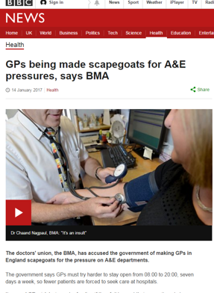
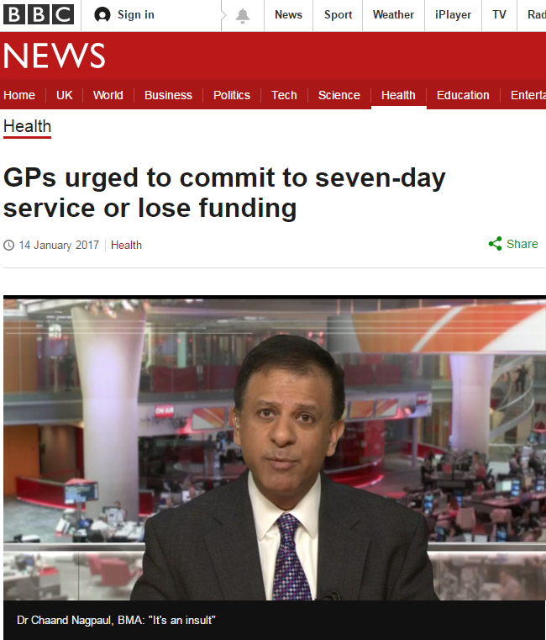
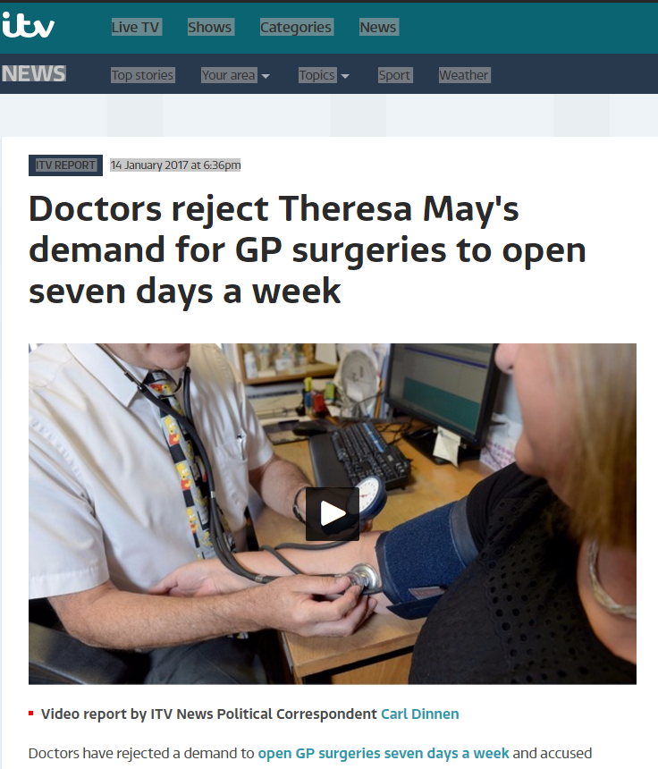
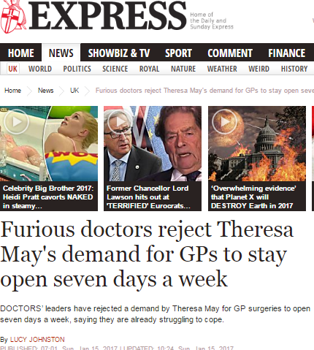
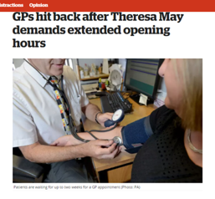
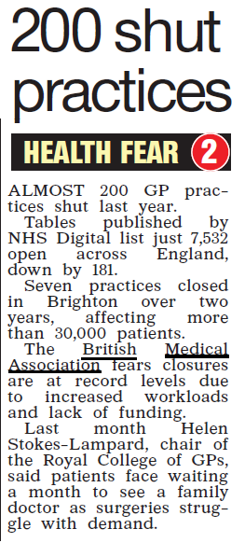
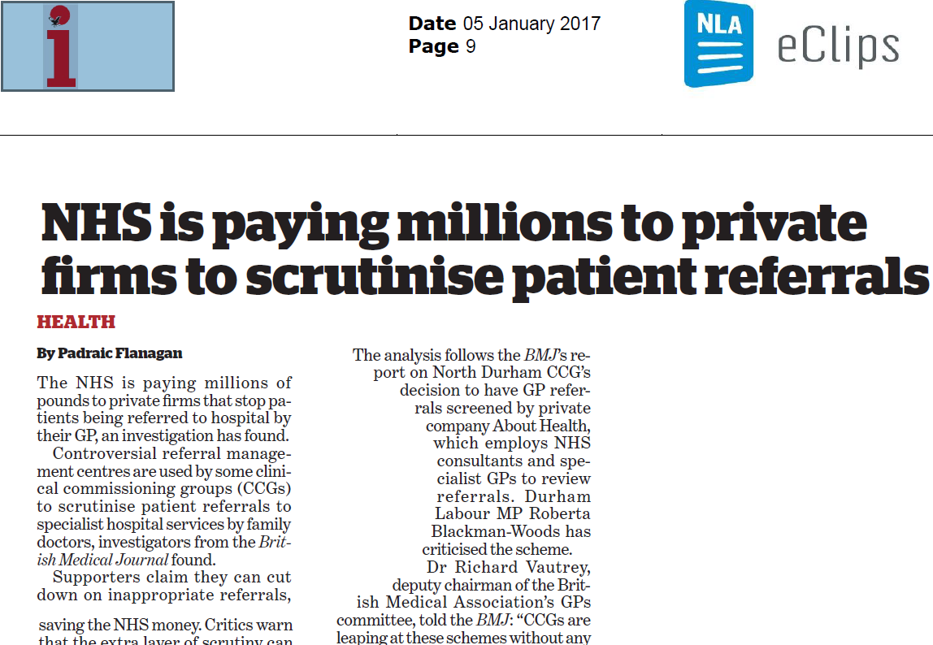
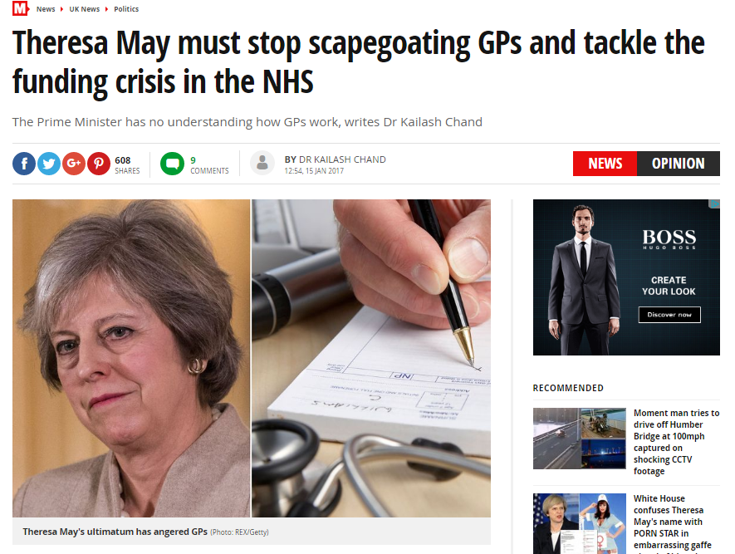
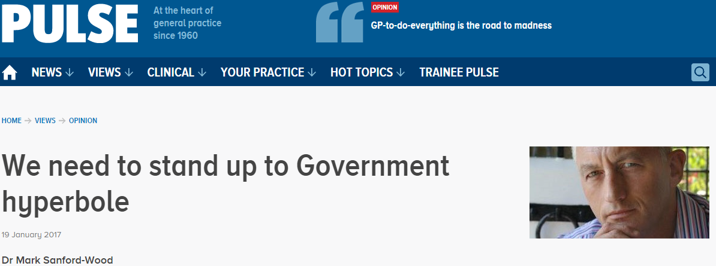
Recent news coverage

Slide 18
Current issues – SBS, TPP QRISK and Capita
SBS note transfer failure – negotiated compensation
      LMCs have been notified
      Practices should now have received copies of correspondence and details of how to claim for workload
TPP and QRISK
      Issue of compensation being addressed and hope to announce soon
PCSE/Capita – compensation being addressed; workload of labelling and bagging records in contract 2017/18

Slide 19
Current issues – firearms
New arrangements April 2016
GPC took lead mid-November (previously Professional Fees Committee)
Task and finish group established
Twin track approach
        Safe advice to cover all preferences
        Engagement with HO to change system
  Augmented comprehensive advice expected mid-Feb

Slide 20
Current issues – private provision to registered patients
  Raised again both in negotiations and directly with NHS England
  Requested change to regulations to allow GPs to provide services not available on NHS to own patients e.g. minor surgery
  Highlighted benefits for patients, GPs and commissioners
  NHS England not prepared to consider because of political sensitivities

Slide 21
Current issues – winter pressures
QOF suspended in Wales, Northern Ireland and Leeds
Written formally to NHS England to demand consideration is given to similar agreement
Tamiflu prophylaxis in care homes
Not covered by GMS contract
Discussion with PHE and NHS England

Slide 22
Current issues – sessional GPs
Indemnity increases
        £30m added to GS in 16/17 contract (approx. £2-2.50 per session)
        Practices need to provide this funding to salaried GPs
        NHS England guidance with GPC input
Intermediaries legislation
Pensions
        PCSE issues for locum GP pensions
Notes:
Indemnity
£30 already going into GS in March 17 for the year 16/17.
MSW and Charlotte are liaising with NHS Eng about how to disperse the £30M from each year to benefit all deliverers of care. Different methodologies can be used, but give a ball-park figure of £2-2.50 per session worked for each year of the uplift.
The treasury are concerned that the £30M from 16/17 (and effectively £60M for 17/18) could be partially captured by partners and converted to profit. If they sense this then future deals may fall. Therefore we must ensure that salaried and sessional Drs get their proportionate allocation.
NHS Eng are working on guidance (with our input). Partners should expect to disperse this resource. Note that the 16/17 money will come in March 17 and it is unlikely that locums and salaried Drs have been charging the extra £2 per session, so 16/17 money will end up as profit for Partners. Some sessional Drs are unhappy that we did not issue guidance last April so that they could introduce the surcharge then (just to warn of the possible sessional angle of questioning)
Intermediaries legislation
Change in tax legislation could make practices responsible for locum tax and NI contributions in certain situations
Formally raised with HMRC and DH to make sure this doesn’t happen.
Pensions
Lack of clear processes (what forms are needed etc) and delays in processing paperwork for locum pensions
Continued engagement with PCSE to resolve issues

Slide 23

GP Forward View
Announced 21st April 2016
5 year support programme
£2.4 billion extra recurrent
funding by 2020/21 (14 vs 8%)
£506 million over 5 years for Sustainability & transformation non-recurrent
>10% NHS budget by 2020/21; CCG investment on top
Result of GPC UP lobbying
Change in tone by NHSE
What NI GPC are campaigning for
Notes:
Comprehensive package of support to General Practice
Funding will rise to at least 10.4% of NHS spending (close to our call of 11%)
Majority of our asks in Responsive, Safe and Sustainable included – and commitment to discuss outstanding proposals
BUT: proof will be in the pudding

Slide 24
GPFV headline areas and progress (1)
Practice resilience programme (£40m) -2016/7: £16m – needs to be given to practices by 30 March
Indemnity fees increase reimbursement – 2017/18 contract negotiations, OOH – 2016/17 winter indemnity scheme; longer term solution via GP Indemnity Review Group
CQC expense rise recompense – contract negotiations
Support for burnout and stress (£16m)- just gone live
GP Development Fund to manage workload/shape demand (£96m) –started this year
Transformation monies 17/18 onwards for working at scale (£171m) – to go live April 2017 onwards
Review mandatory training – working with RCGP
Commitment national self-care programme – discussions with NHSE
Notes:
Many funding straddm come in later – cannot judge GPFV but we need to be proactive and vigilant e,g £171m as of 2017/18 onwards
Access- we negotiated removal of 7 day 8-8 and it can be used to support in hours GP

Slide 25
GPFV headline areas and progress (2)
GP access monies:
£500m recurrent by 2020/21
Phased investment- all areas to receive £6 per head by 2019
No requirement for 8-8 7 days; local determination for weekend access hours
Can be used to support in-hours GP capacity
Can be for urgent appointments, and integrated with urgent care/GP OOH
Can be delivered via locality hubs
Need to use to support current GP pressures; overflow work
Notes:
Not all initiatis about money
Seonrya to priary care wirkoad dunoing has dogged generl rpactie0 it si a big issues for GPs
Primary/Seconday interface group specifically to deal with this
Mandatoru traingin –after our lobbying- with RCGP

Slide 26
GPFV: Primary-secondary care interface
Hospital standard contract changes to reduce inappropriate secondary care shift – went live 1 April 2016
Issue | 2016/17
Referrals | Hospitals to stop asking GPs to re-refer DNA appointments Hospital to make internal referrals for related problem and not ask GP to re-refer
Communication with the patient and fit notes | Hospital to follow up investigations and inform patient
Discharge summaries | Discharge summaries within 24 hours
Clinic letters | Clinic letters within 14 days
Drugs | Adequate supply drugs on discharge
Notes:
GPC has made significant progress on the primary-secondary care interface, aimed at reducing bureaucracy and limiting workload shift from primary to secondary care.
The interface group recognised an estimated 15m wasted GP appointments due to transfer of work from hospitals.
Some of the highlights from the work we did last year are shown here; significant wins include the need for hospitals to make internal referrals for related problems rather than refer back to the GP for them to re-refer, time limits on receiving correspondence from hospitals, and hospitals providing an adequate supply of drugs on discharge so the patient doesn’t have to see their GP to get the quantity they need

Slide 27
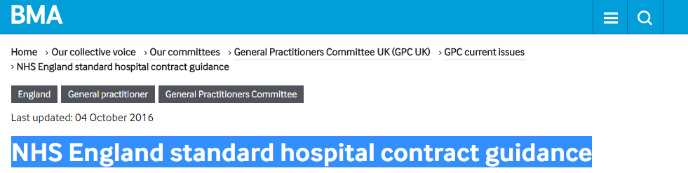
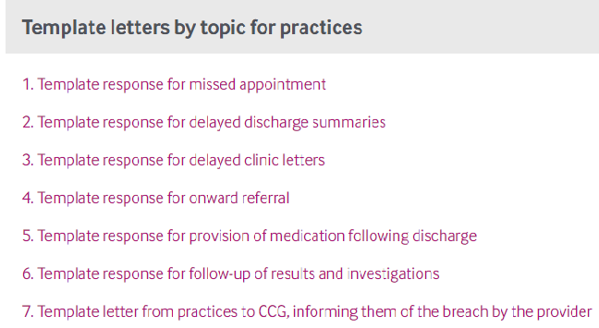
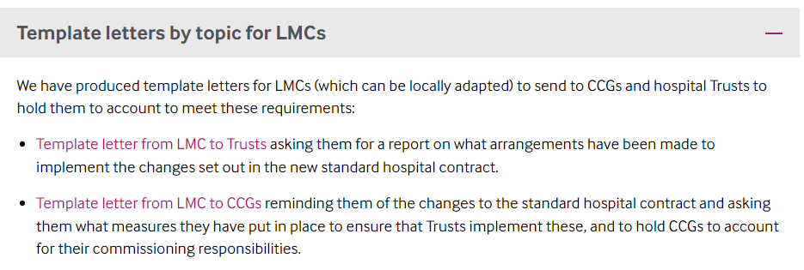
Notes:
GPC guidance
Templates embedded into clinical systems

Slide 28
GPFV Primary-secondary care interface (2)
Dedicated GPFV primary-secondary care interface group to address interface problems and workload shift – Urgent Prescription priorities
Issue | 2017/18
Communication with the patient and fit notes | Hospital to put in place arrangements for handling patient queries (from patients and GPs) Hospital to issue fit notes to patients where needed
Discharge summaries | Discharge summaries from A&E within 24 hrs and direct electronic transmission from Oct 2018
Clinic letters | Clinic letters within 10 days (April 2017) and 7 days (April 2018) and move to electronic transmission using structured clinical headings (Oct 2018)
Prescribing | Dedicated prescribing interface group. Outpatient and specialist prescriptions, share care arrangements, use of hospital FP10s and developing hospital EPS, hospital monitoring of specialist medications
Notes:
We will also see significant progress over the coming year with changes to electronic transfers of information and hospitals issuing fit notes.
Here is a list of what we already know is going to happen, but we are working hard with NHS England to ensure that this is built upon and there are significant other wins over the coming year.
Other things being looked at:
Templated working - ensuring all Referral templates are uptodate and integrated into IT systems (this will require local leadership)
Patient self referrals, national system of referrals for things like physio, counselling, antenatal, weight management, addiction
Stop private referral requests (from insurance firms), they should have their own setup for vetting referrals and not be using NHS GPs or NHS time to generate free referrals
Stop to housing and school letter requests. (This one needs a bit more thinking ).
National minor ailment scheme
A list of minor illness which should be encouraged to see Pharmacists first (with exclusion criteria and caveats).

Slide 29
GPFV progress: workforce
GP recruitment and retention:
Induction and Refresher Scheme
GP Targeted training programme
Improved retainer scheme
International doctors recruitment
GP mental health service (to prevent burnout)
20k bursary in under-doctored areas
Practice based pharmacists (£112m ;1 pharmacist/30,000 pts) –just announced
1000 PAs, 3000 practice based mental health workers (1 per 2- 3 practices)
Extended scope practitioners; enhanced nurses, paramedics, physios
Training funds for practice managers (£6m) , nurse development (£15m), reception staff training & clinical admin support (£45m)
Medical assistant pilots

Slide 30
GPFV General Practice Development Programme
Releasing Time for Care – 10 high impact areas (£30m) 67 groups (2,000 practices signed up)
Training for reception and administrative staff (signposting, handling incoming clinical correspondence) (£45m)
Practice manager development (£6m)
Online consultation systems (£45m) – e.g. Askmy GP, WebGP or smartphone apps – available April 2017 onwards
Need LMC/practice and CCG awareness – small amounts of money will stretch much further with groups of practices
Notes:
It’s easy to be cynical
Small pockets
BUT case studies have shown real change in many of these
Small sums can stretch much further across groups of practices. Even federations

Slide 31
LMCs vital to ensure local implementation delivery
GPC: GPFV implementation policy group; central pressure and oversight; NHSE GPFV advisory group
GPFV delivered locally; CCG plans 23.12.2016
LMC role – monitor, influence, ensure commitments and spend delivered
LMC reference group for GPFV set up – direct engagement with NHS England; real time- feedback
Guidance to LMCs with LMC checklist for CCGs GPFV plans (December 2016) and monitoring template (January 2017)

Slide 32
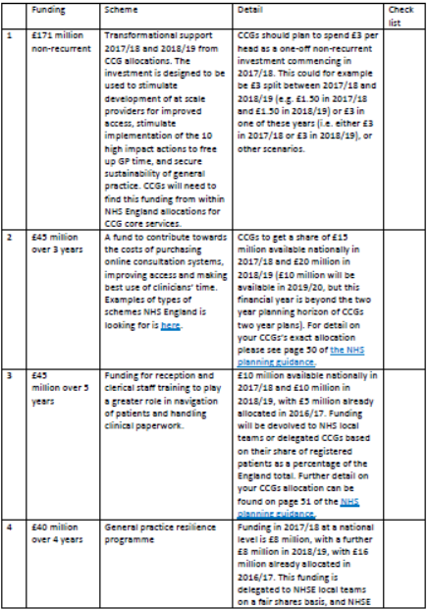
GPFV LMC engagement (1)

Slide 33
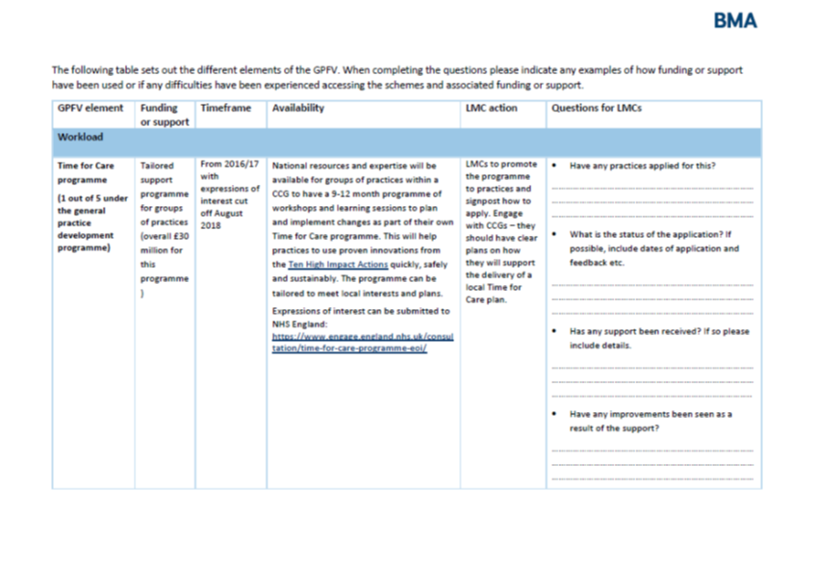
GPFV LMC engagement (2)

Slide 34
GPFV: premises
Awaiting updated Premises Cost Directions
    Includes 100% funding for premises grants
NHSPS lease agreed
    Support for practices signing the lease within two years of release:
        Stamp Duty Land tax covered
        Legal fees paid (up to £1000+VAT)
  Service charges transitional support – discussions ongoing
    Any NHS PS or CHP premises will receive transitional support if their service charges have risen recently
        Two years of NHS England automatic support (i.e. no need to claim, will automatically be done between NHS England and NHSPS/CHP, and identifiable on the invoice)

Slide 35
GPFV: GP Health Service
Launched this week – based on model operating in London
Free, confidential service for GPs suffering with mental health or addiction issues
Self referral only
Contact details:
Opening hours: 8.00 – 20.00 weekdays and 8.00 – 14.00 Saturdays
Website: www.england.nhs.uk/gphealthservice
Tel: 0300 0303 300 Email: gp.health@nhs.net
Notes:
A free and confidential service for GPs and GP trainees working or looking to return to clinical practice in England who are suffering with mental health or addictions issues.
The NHS GP Health service will help GPs with:
- Common and more complex mental health conditions
- Mental health conditions relating to a physical health issue
- Substance misuse including support for community detoxification
- Rehabilitation and support to return to work after a period of mental ill-health.
The service may be accessed by:
- Any general practitioner or GP Trainee who is registered on the National Performers List in England.
- Any GP or GP trainee who is looking to return to clinical practice after a period of absence.
The GP Health Service:
- is not an Occupational Health service, it is a treatment service. GPH clinicians may link with local OH services to support a GP patient’s return to clinical practice. If OH support is what you need, please contact the NHS England regional team to identify your local OH provider.
- is not a replacement for mainstream NHS services, nor is it designed to offer a second opinion. GPs who are currently supported by NHS mental health services would be encouraged to remain with their local treatment team, but could seek guidance on particular aspects of care, or support for return to work.
- can offer independent support to GPs who are undergoing performance proceedings, but it can not be used to provide health reports to inform PAGs or PLDPs. Formal assessment of health issues should be commissioned from a separate organisation.
Examples of treatment available:
- Assessment and case management provided by GPs, psychiatrists, and specialist mental health and addiction nurses
- General psychiatry
- Addiction psychiatry
- Psychological therapies, e.g. Cognitive behaviour therapy (CBT)
- Short term psychotherapeutic interventions
- Local interventions /groups (therapeutic groups to address specific issues affecting mental health in a particular area)
- In very exceptional circumstances, on an anonymous pre-approval basis inpatient addiction rehabilitation may be available.

Slide 36

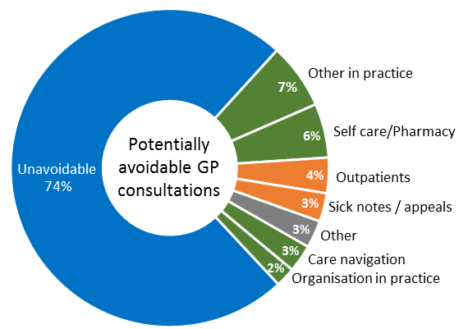
Managing Workload and demand: potentially avoidable
GP consultations
Self-rating by GPs
1 in 4 GP appointments potentially avoidable
“Making Time in General Practice” report – NHS Alliance/Primary Care Foundation
Notes:
IF inadequate money then managing demand and workload should be priority
Previous data from LMCs too

Slide 37
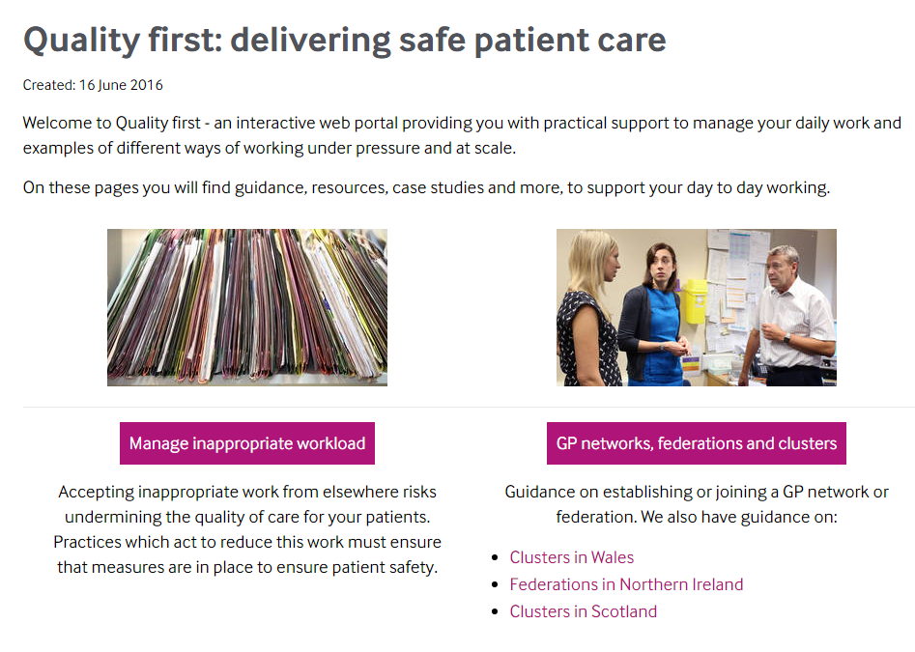
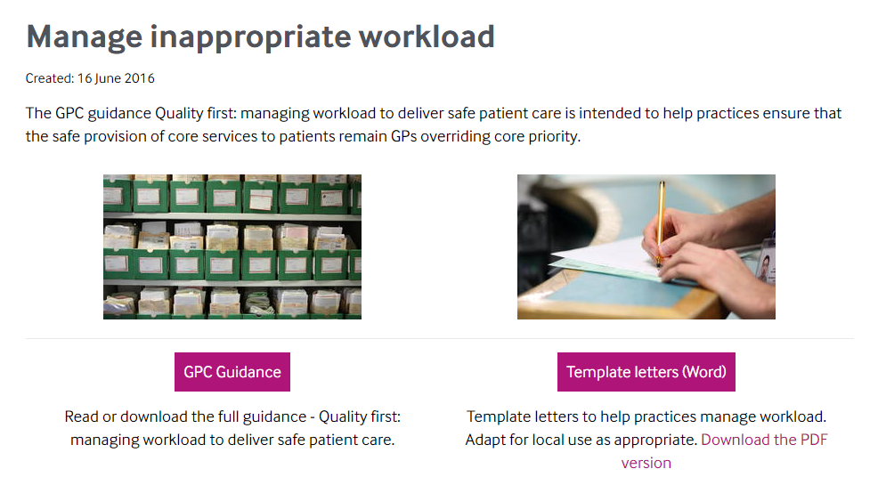
Quality First website (www.bma.org.uk/qualityfirst)
Notes:
A dynamic webpage
We want real life examples from LMCs

Slide 38
BMA GP survey – some key findings (1)
GP partners under greatest pressure
6% partners feel work manageable c.f. 12% salaried GPs, 34% locums
Only 1 in 5 partners content with current job; 1 in 3 looking for alternative work
Just under half GPs (47%) want to work as partners in the next 5 years
79% GPs believe there should be incentives to work as partners
GPs want varying career options, willing to consider other models – 32% willing to work in new care models, 19% employed in MCPs
Measures to reduce workload: self-care/management and increased community nurses and skill-mix most popular
New funding in general practice – highest responses for increased community nurse and skill-mix support (46%), 28% wanted all investment in global sum

Slide 39
BMA survey: action to reduce workload
Q2. | Which of the following would you consider doing in order to safely manage practice workload?
Withdrawal of wider non-contractual services that GPs voluntarily provide | 60.7 %
Restricting clinical work to contractual essential services, and increased use of external referral for non-core services | 40.9 %
Withdrawal from local CCG meetings and activities | 35.2 %
Temporary suspension of new patient registrations | 34.1 %
Withdrawal from enhanced services, such as the provision for minor surgery, extended hours | 34.0 %
Working at scale | 33.6 %
Application to reduce practice boundary and remove patients from the list | 26.0 %
Withdrawal from the quality and outcomes framework | 23.4 %
Withdrawal from additional services, such as the provision of contraceptive services | 14.2 %
I don’t need to take any further measures to manage workload | 6.2 %
Other | 23.8 %
The list of items provided is the list from the briefing on industrial action of possible actions that could be taken
Notes:
The list of items provided is the list from the briefing on industrial action of possible actions that could be taken
The results show that most GPs are willing to stop non-core, voluntary work
There is no great willingness to stop work that will lose money to the GP

Slide 40
Working together to sustain general practice
Individual GP practices vulnerable
Working collaboratively to support each other
BMA GP survey: One model no longer fits all
49.6% believe ICM should be supported to work in networks/collaboration (c.f 47.2% supporting ICM as prime model)
32% support multi-professional collaborative model including MCPs
Prime reasons for collaborative working : reduce bureaucracy, workload, extended access; security and sustainability of practices within a larger organisation
Notes:
When it come to working together, it is not just about MCPs. There are a number of different models that practices can use to work together the reduce workload and make general practice sustainable.
And there is definitely appetite out there for working together.
Our survey of GPs in England showed that less than half of GPs would like the independent contractor model developed in the future, with more than half supporting collaborative working
A third said they would consider working at scale and another third said we should collaborate with other healthcare staff

Slide 41
MCPs (multispecialty community providers)
Scale 30,000+ population, groups of practices
6 pilot sites 2017/18
MCP contract advisory group
3 contractual options-practices can retain G/PMS
10-15 year contract with MCPs; unified capitated population budget
Practices can have alternative subcontracts in MCPs, “right to return” (logistics?)
GPs can be employed by MCP
VOLUNTARY – practices can be part of MCPs by retaining current national contract
Alternative voluntary contracts being developed
Virtual MCP
Alliance agreement
Partially integrated MCP
G/PMS for core general practice
Fully integrated MCP
Single MCP contract for all primary care and community services
MCP contract for all other services
No change to current contractual arrangements
Notes:
We negotiated models allowing continuation of national G/PMS

Slide 42

Contracts and services within an MCP
CCG/Commissioner
Core contract
GP practice
GP practice
GP practice
GP practice
Non-core services
MCP
Sub-contract with MCP
Alternative MCP contract
MCP
GP practice
GP practice
GP practice
Community services
Out of hospital specialist clinics and diagnostics
Secondary care services contract
Hospital services
Highly specialised services
8

Slide 43
Move away from national contracting
  Undermines a consistent standard of national and equitable care to patients
  Local GP contracts: Loss of national protections and T&Cs; increased bureaucracy in local negotiations
    QOF achievement will still be monitored and performance managed (NHS E primary care web tool, CQC)
    New performance pay to replace QOF? Net increase workload?
  A significant move towards a locally determined contract would undermine the collective bargaining rights for remaining GMS practices.
  Locally determined employment models would undermine national model contract for salaried GPs.
  Procurement

Slide 44
What practices should do now
  The MCP contract will initially affect practices in one of 6 MCP pilot sites
  Being considered in many STP plans
  Remember any MCP involvement is voluntary – do not feel coerced
  GPC guidance; can seek LMC or BMA advice
  Consider carefully: organisational;/legal/financial implications – need specialist professional advice
  GP practices can work at scale other than in MCP arrangements with aim to support practice workload and sustainability
  LMCs should support practices to develop bottom-up GP owned models – offer lifeline to practices as alternative to MCPs

Slide 45
GPs working at scale – emerging realities
Practices working collaboratively as network provider/federation
Devo-Manc and others
Development of MCPs
Primary care home
Super-practices - c.50 in England with 30,000+ patients
Acute Trusts running or contracting with GP practices
PACS/ACO development
Emphasised in the GPFV
Funding is available via the transformation fund (£171m) and the access fund (£500m)
Notes:
It’s happening
GPFV resources

Slide 46
Working at scale – supporting practices, managing workload, developing the workforce
Network provider/hub
Community provider
Supporting practices
Managing workload
Developing the workforce
Management Back office Proactive/ crisis support
‘Overspill’ urgent cases telephone triage remote admin
Employer of staff Sessional GPs Skill mix e.g. pharmacists Education and training
Integrated nursing teams
Shared staff
Shared services
Cross cover
GP practice
GP practice
GP practice
GP practice

Slide 47
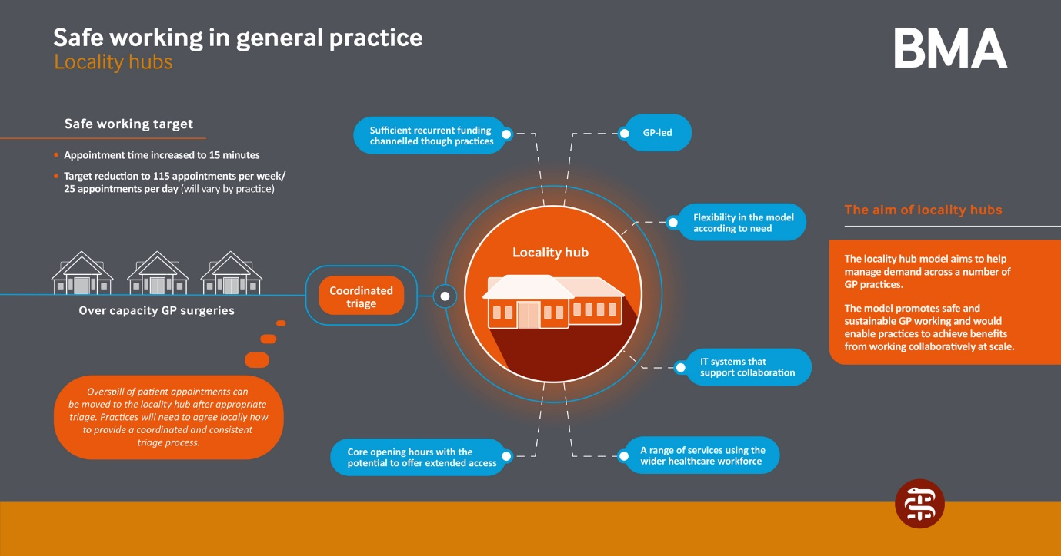
Notes:
Safe working locality hubs
One option
Based in real case studies
We’ve thought of ways of mitigatinv legitimate concerns
In discussion with NHS E as part of UPGP
We’re happy to her fo alsternative ways of limiting workload

Slide 48
Case Study (Federation): Essex
How it works | How it’s helped
9 practices (50,000 patients) Working together through a Memorandum of agreement between the practices Agreed Care/Nursing home visits Sharing minor illness clinics Allocated slots depending on list size Jointly commissioned training Agreed pathways Risk share agreed | Reduced bureaucracy Practices more sustainable Manageable practice workload Economies of scale
Example from Essex: 9 practices (50,000 patients)
Working together through a Memorandum of agreement between the practices
Managing workload by:
    Agreed Care/Nursing home visits
    Sharing minor illness clinics
    Allocated slots depending on list size
Notes:
This example is taken from Essex, but we have heard of similar collaborative working through Federations in Leeds (ADD IN WHERE ELSE)

Slide 49
Case Study (Hub): Richmond, South West London
How it works | How it’s helped
Local GPs (28 practices) operate 4 Hubs, each based in an existing general practice surgery Each Hub can access any patient’s notes (with their permission). Read and write interoperability between GP systems so instant updates and fully-coded entries. Practices triage calls, decide who can and should be seen at the Hub, and book the appointments. Hub GPs see 14 patients over 4 hours at 15 minute intervals. Practices meet regularly as localities to discuss the functioning of the Hubs, equity of access to appointments, and to develop the service. Extending access to support a local Pharmacy First project (to encourage patients to use pharmacy for minor health care issues), and discussing integration with out of hours services. | Hubs add another 5-8% appointments in to the system – taking some strain off local general practice Stops extra appointment availability from driving further demand. Extra resilience Hubs have helped to smooth over periods of staff sickness or leave Positive impact on A&E and urgent care numbers

Slide 50
Case Study (Super-partnership): Birmingham
How it works | How it’s helped
33 practices Population covered 290,0000 and growing with a number of practices going through "due diligence.' Profit Centre model, common in industry, rare in medicine. Single partnership, with original contracts held centrally in trust. Small central corporate team paid for by levy of £2 per patient (tax deductible) Elected board of 7 GPs from across the partnership. Considerable local autonomy (both managerially and financially) with added advantages of being part of a very large partnership. | Single CQC registration, with light touch inspection as per GPFV. Practice quality and support team to reduce duplication and bureaucracy in practice. Sustainable workforce model, starting with internal bank and Salaried Doctor pool to reduce locum costs and increase quality. Reduction in medical indemnity costs and investment in training. Central accounting and banking with monthly management accounts and quarterly benchmarking. Access to buyers scheme discounts. Increased resilience with peer support from other practices. Opportunity for further closer merger and sharing of back office functions Greater local and also national influence

Slide 51
GPC/LMC partnership
Increased and more timely guidance and support
Input from lead LMCs e.g. Humberside LMC paper on GPFV funding stream; NHS property lease
LMC reference group interface with NHS England
More regular executive updates; planning webinars
LMC events: Working at scale conference 23 February 2017
GPFV implementation and workload management conference planned April 2017

Slide 52
Supporting LMCs Guidance produced for LMCs since January 2016
Focus on funding support from the GPFV
Co-commissioning guidance
GMS Contract and PMS comparison document for LMCs
Physiotherapy guidance and cost calculator
Focus on the publication of earnings
Guidance on urgent prescription
Service charges
NHSPS lease guidance
Gender incongruence
Focus on the NHS England General Practice Forward View
GP locum chambers guidance
Template lease for GP premises, and associated guidance
Patient registration
Safeguarding reports and collaborative arrangements
Focus on PMS reviews
Focus on MCP Contract Framework
Focus on industrial action and undated resignations
Finances of the contract agreement
Focus on GP funding changes
NON-GUIDANCE: GPCE monitoring of Capita performance

Slide 53
In summary…
Operating within grossly underfunded NHS
Successful GP contract negotiation 2017/18
General practice as part of a wider environment
GPFV committed resources must be spent and delivered to support general practice
GPC/LMC partnership vital
Empowering profession to manage workload
Working together; to support sustainability of practices, and models to meet diverse aspirations and needs of GPs
Political pressure/lobbying – general practice needs larger proportion of a larger NHS pot –political choice

