Slide 1
Our Health Partnership

Slide 2
Our health partnership
Creating Britain’s largest General Practice partnership
Dr Vish Ratnasuriya
GP partner, and Chair of Our Health Partnership
Dr Will Taylor
GP partner, and Member of OHP Board

Slide 3
Our health partnership
Why? - Current context for general practice
Recruitment difficulties, falling income, rising workloads
Administrative burden for partners is becoming unsustainable
Most consultations each day are in primary care, so even a small drop in capacity will have a significant impact elsewhere
Need for greater system integration BUT local responsiveness valued highly by patients
Group of successful high performing practices wanting to make the change
General Practice at scale can offer effective solutions - but maintaining freedom to innovate and respond locally is critical

Slide 4
Our health partnership
Why? - The future context for healthcare
Need for more proactive care, maintenance of community focused well being, less hospital based
Move towards local system solutions
ACO model, single organisational lead, responsible for defined population
A sound foundation of effective, locally responsive and sustainable General Practice is essential

Slide 5
Our health partnership
Why? - General Practice at scale
Benefits of scale – economy, workload
Share challenges and solutions eg salaried doctor pool rather than ad hoc locum cover
Influence as ‘system player’ – a strong voice to start shifting the emphasis of care provision
Potential to develop towards a broader provider (MCP)
How can we do this without ‘corporatisation’ and removal of self-determining local General Practice provision?

Slide 6
Our health partnership
How - What we mean by “scale”
Partners 155 (with 50 salaried GPs)
Practices 33 (likely +10 from May 2017)
Patients 280k+ (likely increasing to 370k patients in May 2017)
Staff 780
Income £55m+
Our Health Partnership has a list size comparable to the population covered by many CCGs, or served by a local acute hospital.
This creates opportunity - and collaboration with others is starting to increase our scope still further

Slide 7
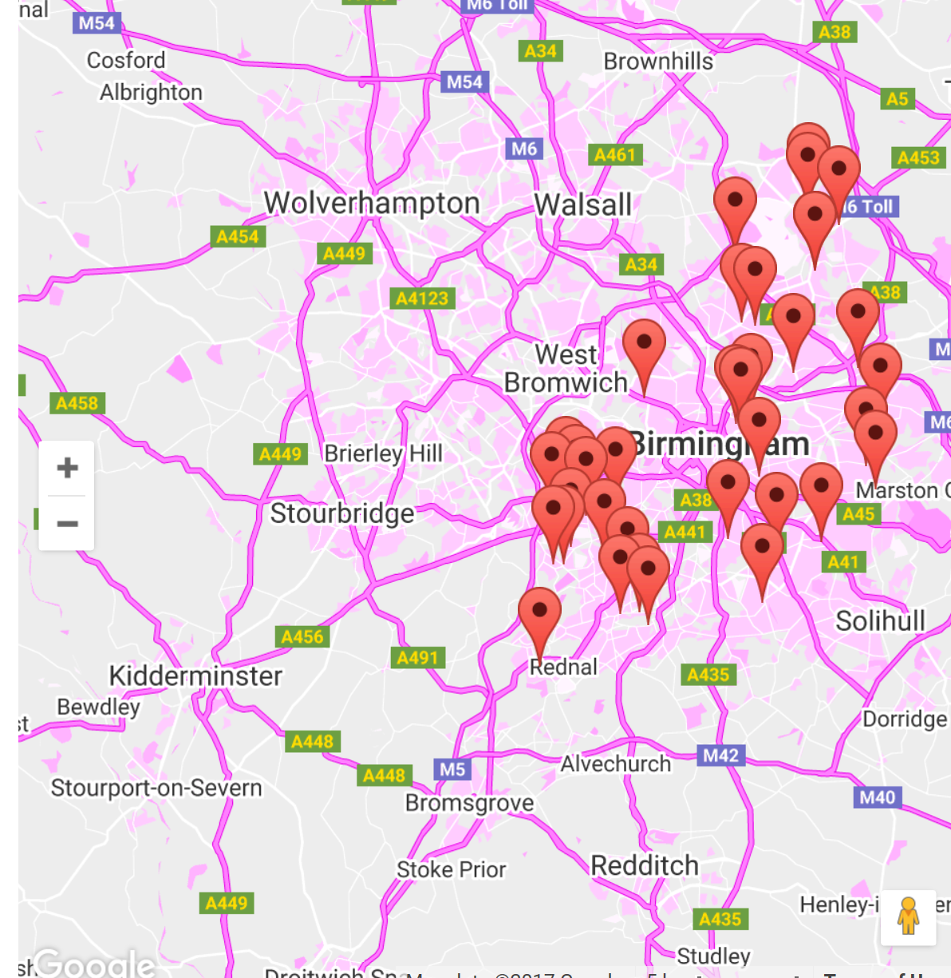
Our health partnership

Slide 8
Our health partnership
How? - Our fundamental principles
Locally responsive, partner-based General Practice with decision-making powers …. good for doctors and for patients
A single Board and a single purpose, but not a single way of doing things
A partnership, not a corporation – support, not control
Autonomy model but with a supporting structure
Strong General Practice will provide a firm basis for a strong local healthcare system
Our Health Partnership believes in independent contractor based General Practice

Slide 9
Our health partnership
How? - Governance
Partnership Deed signed by all Partners – legal entity
Managed by Board – 7 elected Managing Partners, 3 appointed Officers
Practices remain – separate contracts held in trust, local profit centres, with local operating agreements based on previous local partnership agreement
Staff employed by Our Health Partnership
Practices pay an annual subscription to Our Health Partnership based on list size
Stronger than a federation - but not a centrally-driven organisation with a single way of operating

Slide 10
Our health partnership
How? - Strategic aims
Twin aims:
Strong and sustainable General Practice
Broader service provision, MCP and beyond
Priorities:
Make GP partnership an attractive option for doctors
Sustain and improve the local services that patients value
Integrate and influence at system level – a strong voice
Develop a wider range of services
How can we support our practices to strengthen and develop?

Slide 11
Our health partnership
How? - 2016/17 Objectives
We will make life better for patients and partners by:
Introduce a Quality Support Offer
Collaborate to provide local enhanced services at scale
Introduce new ways of working and staff development
Introduce a sustainable workforce model
Improving access to Primary Care

Slide 12
Our health partnership
To Create Efficiencies
To Ensure Sustainability
Centralised Payroll
Centralised finance and banking team
Centralised HR support
Centralised Procurement
Using our scale to drive down prices
By developing a strong OHP Brand
To grow as an organisation
To improve our own leadership and Board development

Slide 13
Our health partnership
Developing OHP
To establish a strong voice for General Practice both locally and nationally
To bid for large contracts, like referral triage and urgent care
To use our size to contribute to research
To look at digital advances, social prescribing and commercial partnerships
To develop into a Multispecialty Community Provider and eventually an Accountable Care Organisation

Slide 14
Our health partnership
What did we want to achieve by April 2017 ?
an established organisation with a central management team providing:
banking
accounting
payroll services
optional range of procurement solutions – including Medical Indemnity offer
support for quality improvement available, and guidance for CQC inspection
CQC Registered Provider
bid for continued funding in 2017/18 and beyond will have been submitted.
quality staff and GP cover, at competitive rates, from an internal staff bank, a locum database and a salaried doctor pool.

Slide 15
Our health partnership
The Challenges and Barriers
Communications – both internally and externally
The costs – not cheap
Managing expectations
Completing things quickly
Ensuring Practice Managers and staff are fully sighted on the rewards and benefits
Sticking to the knitting !!
Balancing autonomy and success at scale

Slide 16
The Rewards - the future
Our health partnership
OHP – 2 YEAR VISION
The largest GP partnership, based in the Midlands, with a developing locality structure
GMS contract-based, with economies of scale balancing practice/locality autonomy
Steady growth in enhanced services, focusing on access and urgent care provision
Backed by unique quality management approach – including governance
Key stakeholder in developing accountable care systems in Birmingham and Shropshire

Slide 17
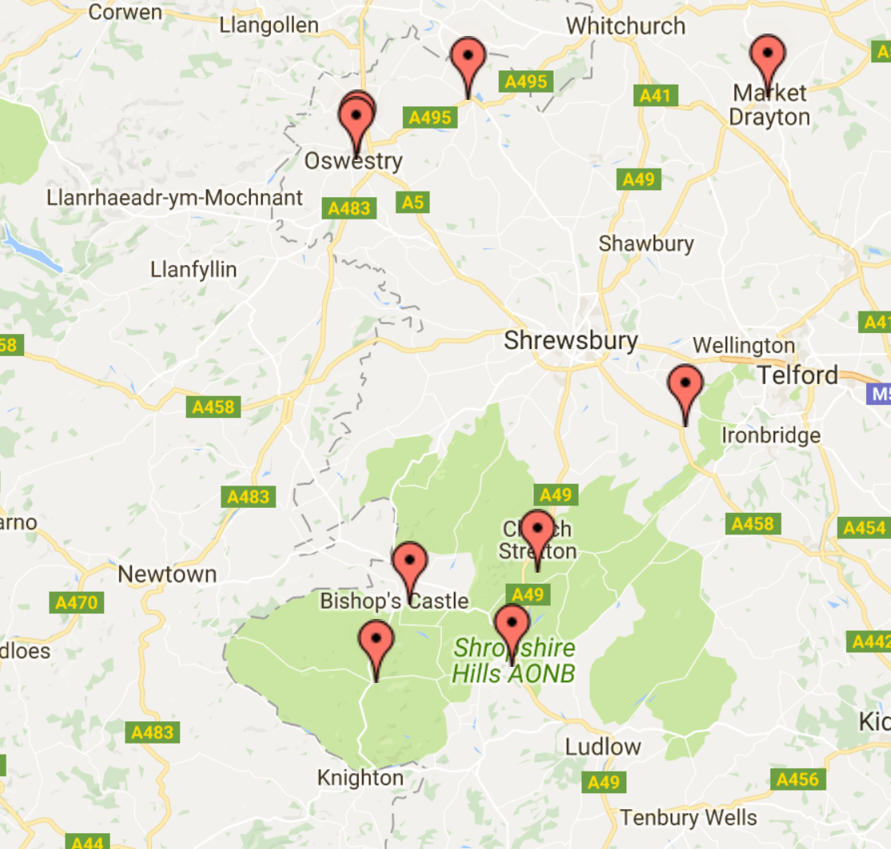
Our health partnership
At May 2017

Slide 18
Our health partnership
Governance
9/8 Board partners
Support locality development
GMS contract-based partnership
Core OHP functions
Quality monitoring & support via ‘virtual team’
Banking, finance & accounting
Procurement
Workforce solutions
OHP into
2019
Branding
OHP branding
Common digital offer
Business development
Function to prepare bids, including ACE support
Strategic / System
Regional / national influencer
Major GP stakeholder in Birmingham and Shropshire ACS’s
Considering national growth
Enhanced services
Increased access / urgent care provision including in-house out of hours
Social prescribing
Mental health partnership

Slide 19
Our health partnership
Summary
A ‘ground up’ organisation, formed by GPs for GPs
Locally independent, partner-based General Practice a fundamental principle
Our scale generates opportunity to influence system development, bring about positive change, and grow from large scale General Practice to a broader healthcare provider
Model is replicable in the urban, suburban and soon rural environments’
Our Health Partnership is the result of independent contractor General Practice partners looking to demonstrate that the model is viable, sustainable, and able to contribute effectively to developing the modern NHS

