Slide 1
GPAS FIRST YEAR REVIEW

Slide 2
Why are we doing this?
General practice pressure visible at system level
Encourages practices to reflect on whether they are coping or need support
Identify which areas need support or prioritising
Drive development of supportive interventions from HCP/ICB or eg (overflow hubs / redirect effectively to UTC)
Anonymous practice level data, held by LMC

Slide 3
GPAS definitions

Slide 4
KENT & MEDWAY GENERAL PRACTICE ALERT STATE SITREP:
w/c 25th September 2023
COUNTY LEVEL DATA
OVERALL GPAS STATUS | RETURN RATES
RED | 46%(3)
IMPORTANT FIGURES
812,670 | MIN NUMBER OF PATIENTS COVERED BY REPORTING AMBER + PRACTICES (1)
109,858 | INDICATIVE NUMBER OF PATIENT CONTACTS IN GENERAL PRACTICE THIS WEEK BY REPORTING PRACTICES ONLY (2)
LOCALITY DATA
DGS | East Kent | Medway & Swale | West Kent
 | GPAS STATUS | RETURN RATES (3)
DGS |  | 50%
East Kent |  | 48%
Medway & Swale |  | 36%
West Kent |  | 49%
COUNTY LEVEL SUMMARY
82% of responding practices are unable to fully meet patient demand and are working beyond recommended safe working limits.
30% of practices have declared they may only be able to maintain safe services for a brief period of time without support and intervention.
86% of practices have signed up to GPAS
This figure is accurate and is the sum of the list sizes submitted from those practices registering as Amber, Red and Black.
This figure is approximate and calculated by using the clinical activity for reporting Kent & Medway practices multiplied by 5.
Response rate of those practices signed up to GPAS

Slide 5
GPAS CHANGE SINCE LAST SITREP
A QUICK GUIDE TO THE GPAS STATES
 | LAST WEEK | THIS WEEK | TREND
DGS
East Kent
Medway & Swale
West Kent
BLACK | Practice may fail within one month. Urgent system intervention required.
RED | Sustainable in the short term. Needs system support.
AMBER | Sustainable in the medium term (6 months max). Probably needs system support.
GREEN | Fully Sustainable
For a detailed guide please click HERE
COMMENTS FROM PRACTICES
Pressure on workforce increasing with having to now undertake and prioritise housebound and care home covid and flu vaccinations. Sickness in admin workforce is affecting morale and patients not understanding of the pressure on general practice. Care Homes generating disproportionate workload.
COVID is on the increase especially in staff. Our flu and COVID clinics are extremely busy adding to staff workload, with little extra resources.
Increasing demand and slow IT systems
High levels of sickness among the staff, no routine appt for six weeks, not sure how long we can keep going like this.
"Increasing numbers of Covid positive patients. Member of the Admin team off with Covid."
We had a major outage on phoneline on the Monday - open reach did not come until afternoon so we in business continuity mode all morning. We also had half staff off sick, flu like symptoms.

Slide 6
The responses tell a story..
Mid January 23
winter pressures
March 23
IT failure
June 23
‘normal State’

Slide 7
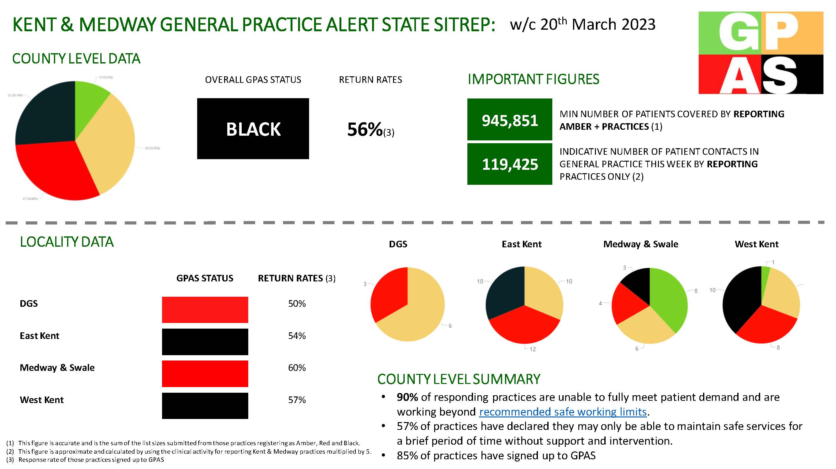
IT Failure

Slide 8
GPAS Comments
another month, another non-payment from PCSE - this time the DES participation payments. when will they be held to account for the havoc they regularly cause to practice and PCN finances & why is nothing done to help practices through this?
amazed that when we are under so much pressure that the ICB is chasing practices to submit daily workforce returns. Who is actually looking at this information and how is it being used to help practices?
demand this week has increased significantly due to the latest health concerns around Strep A. But GP's are reporting the increasing amount of work that is being passed back to primary care from secondary care which needs to be addressed as we are dealing with increasingly angry patients that are being passed from pillar to post and ultimately being told to speak to your GP.
We have had some clinical staff go off with burnout/depression. We are struggling to find locums to cover these staff
Unworkable, unsafe IT issues to contend with this week. Let down and left to face the consequences yet again with the patients as we are left with backlogs and no help.
An absolutely disastrous 4 days in the practice due to the IT issues. Year end for QOF and for payroll so this could not have come at a worse time! Where have the ICB been? A lack of comms and when we did receive an update there is a lack of a clear explanation and the reasons behind the IT issues. Quite an insulting communication from the ICB basically advising us to use "pen and paper". How much more can we endure in general practice. I am seriously thinking of ending my 19 year old career in practice management.
The pressure on general practice is increasing. We are pressured from patients especially as there are long waiting lists. We also have work sent back our way and more and more requests for help as they can't get through to other parts of the service. At this time, all parts of care should be pulling together - this is the only way out of this. The constant "health and wellbeing" is also causing bad feeling as people do not feel that they are being looked after at all! We have patients needing to register with us, but we are so stretched, and list closed. There are going to be 4,000 new residents in one of the new developments in our area, where are they going to go? Partners under a lot of stress, working full days then way into the night to complete their tasks, results and docman -it can't carry on! Now with the shambles of the flu/Covid co-administration just more pain for primary care to absorb.
I have indicated red but we are very close to black. We have a number of clinicians off with Covid. We have to take so much time out of clinical time for tick box exercises and meeting attendance. Staff are at the point of burnout - we have some admin vacancies which are proving hard to appoint to. We are a well managed practice but even we are feeling on the edge! New Contract 23/24 did not help morale as the headlines just make things feel even worse! Retirements are being brought forward in both admin and clinical.
Notes:
Very powerful
Use this to give feedback – goes to stakeholders

Slide 9
Stakeholders
NHSE
HACPs
ICB executives
ICB Primary Care Team
All registered practices

Slide 10
GPAS value
National dashboard
BMA using in contract negotiations and sharing with ministers
Referenced in media interviews & with MPs
Supports LMC in conversations with stakeholders
Comments provide direct feedback to stakeholders

Slide 11
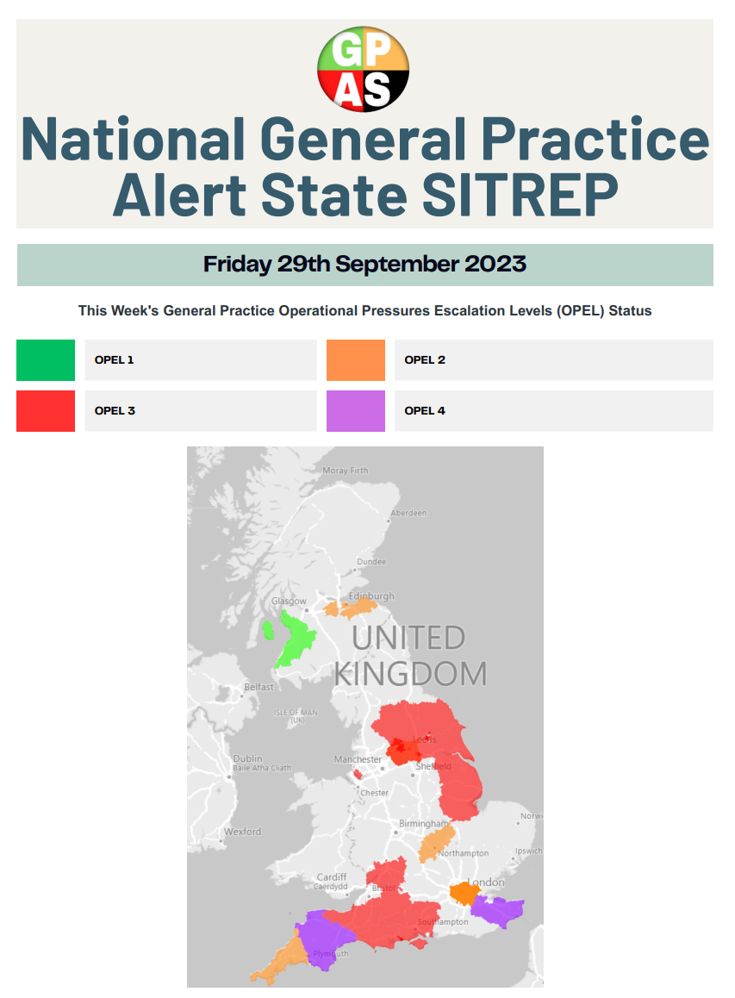

Slide 12
Next steps
Explore viability of integration into Shrewd/Apex
Collaborate with ICB to develop Opel response for general practice
Always going to be long term - need continued practice participation

