Slide 1
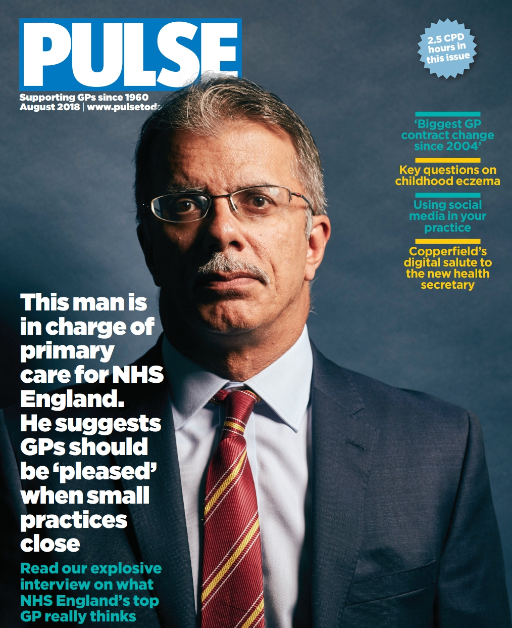

Slide 2
What makes Pulse different to our rivals?
We’re better
Different perception – Pulse more tabloidy? More negative?
More focused on investigations

Slide 3
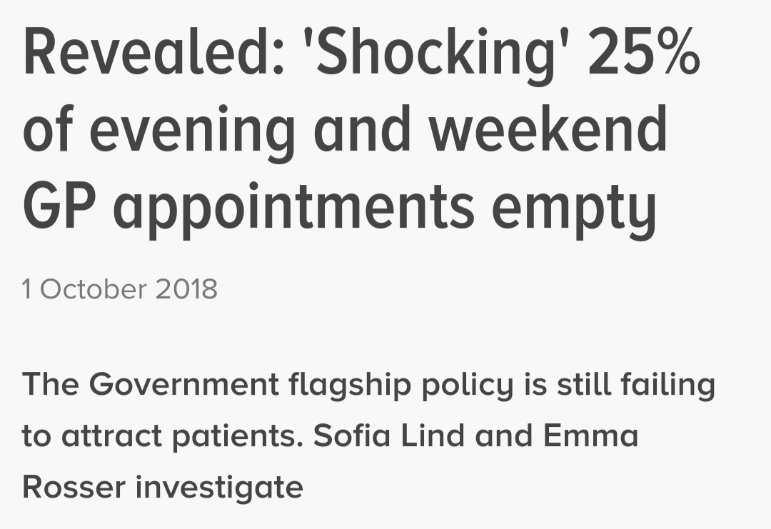
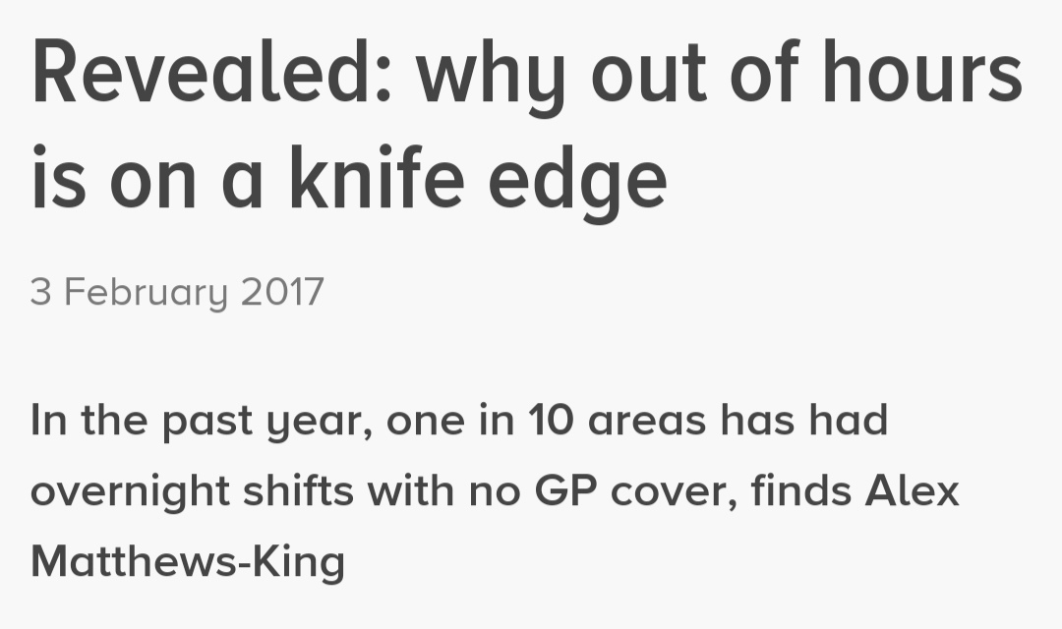
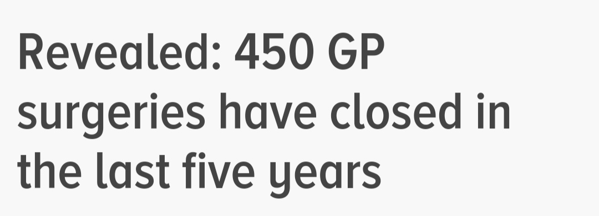
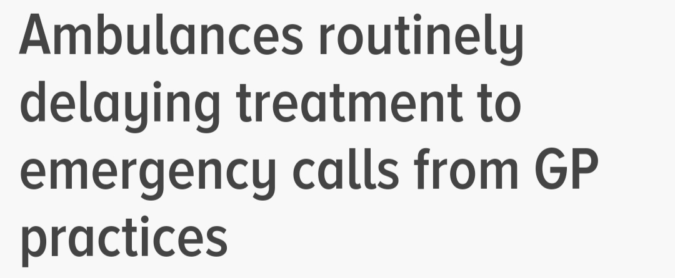

Slide 4
What makes Pulse different to our rivals?
We’re better
Different perception – Pulse more tabloidy? More negative?
More focused on investigations
Funding – we rely on advertising

Slide 6
What makes Pulse different to other B2B publications?
Campaigning – we consider ourselves to be advocates of GPs
GPs!
Held to higher standards
We do NOT criticise our readers…

Slide 7
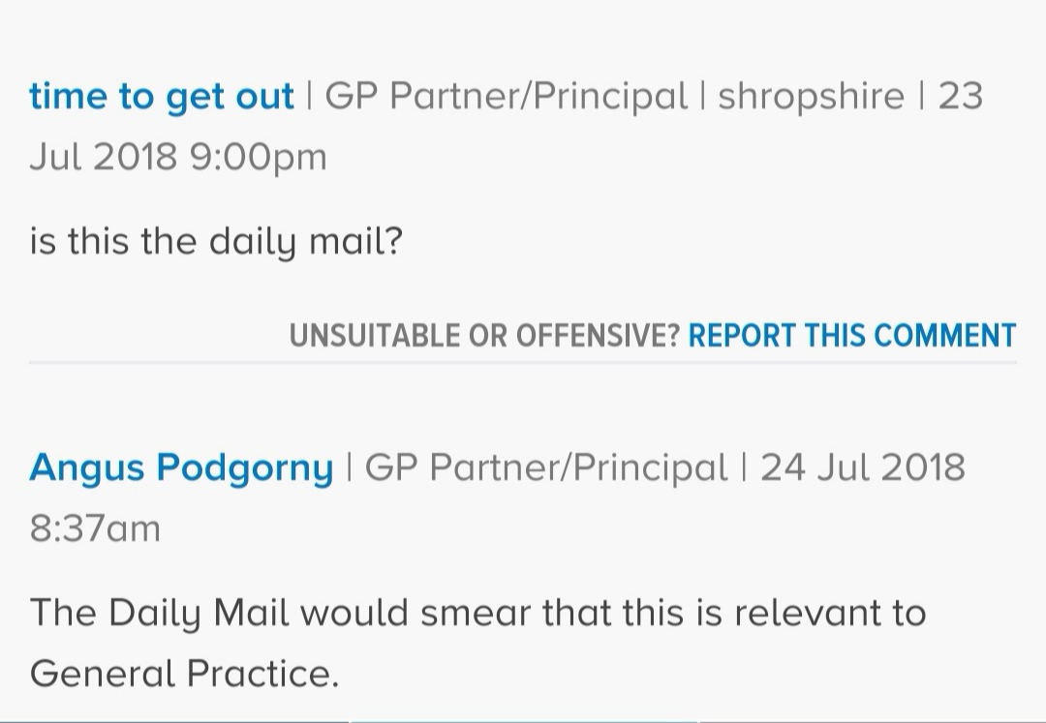
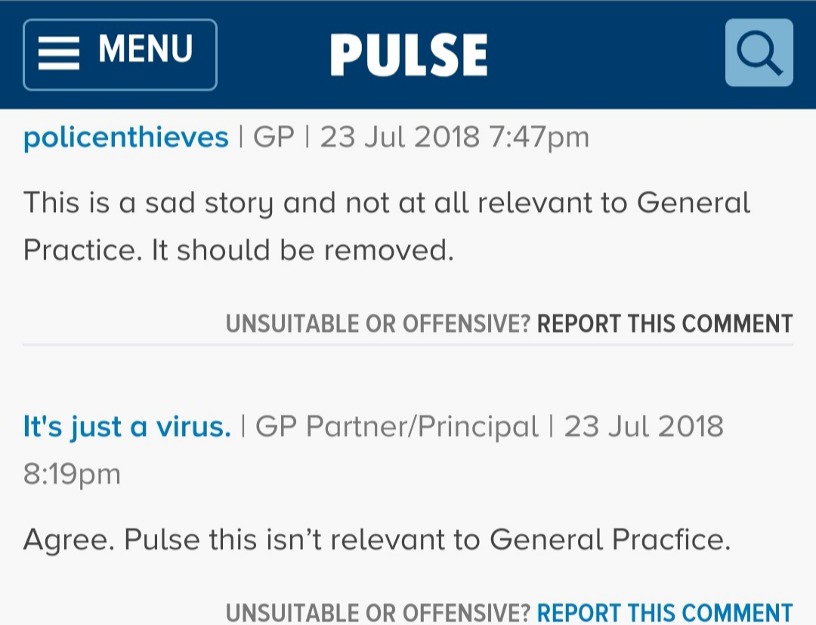
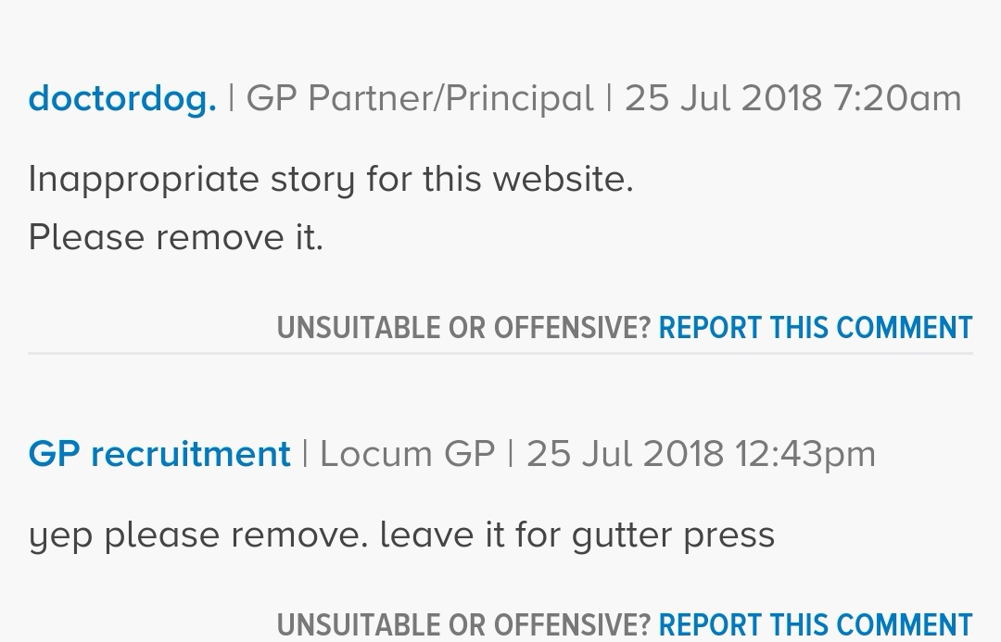

Slide 8
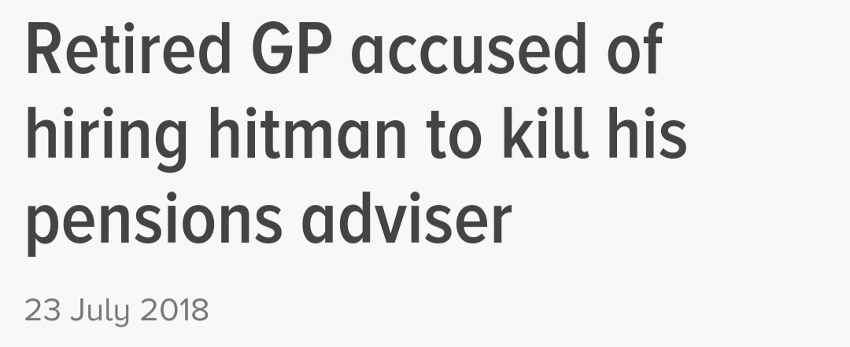

Slide 9
What can you do to help us?
Tell us when you have a story
Fill in our surveys
Offer comments on stories
Give us constructive feedback

Slide 10
And what we can do for you…
Raise the profile of general practice in the media – hundreds of national media mentions every year

Slide 11
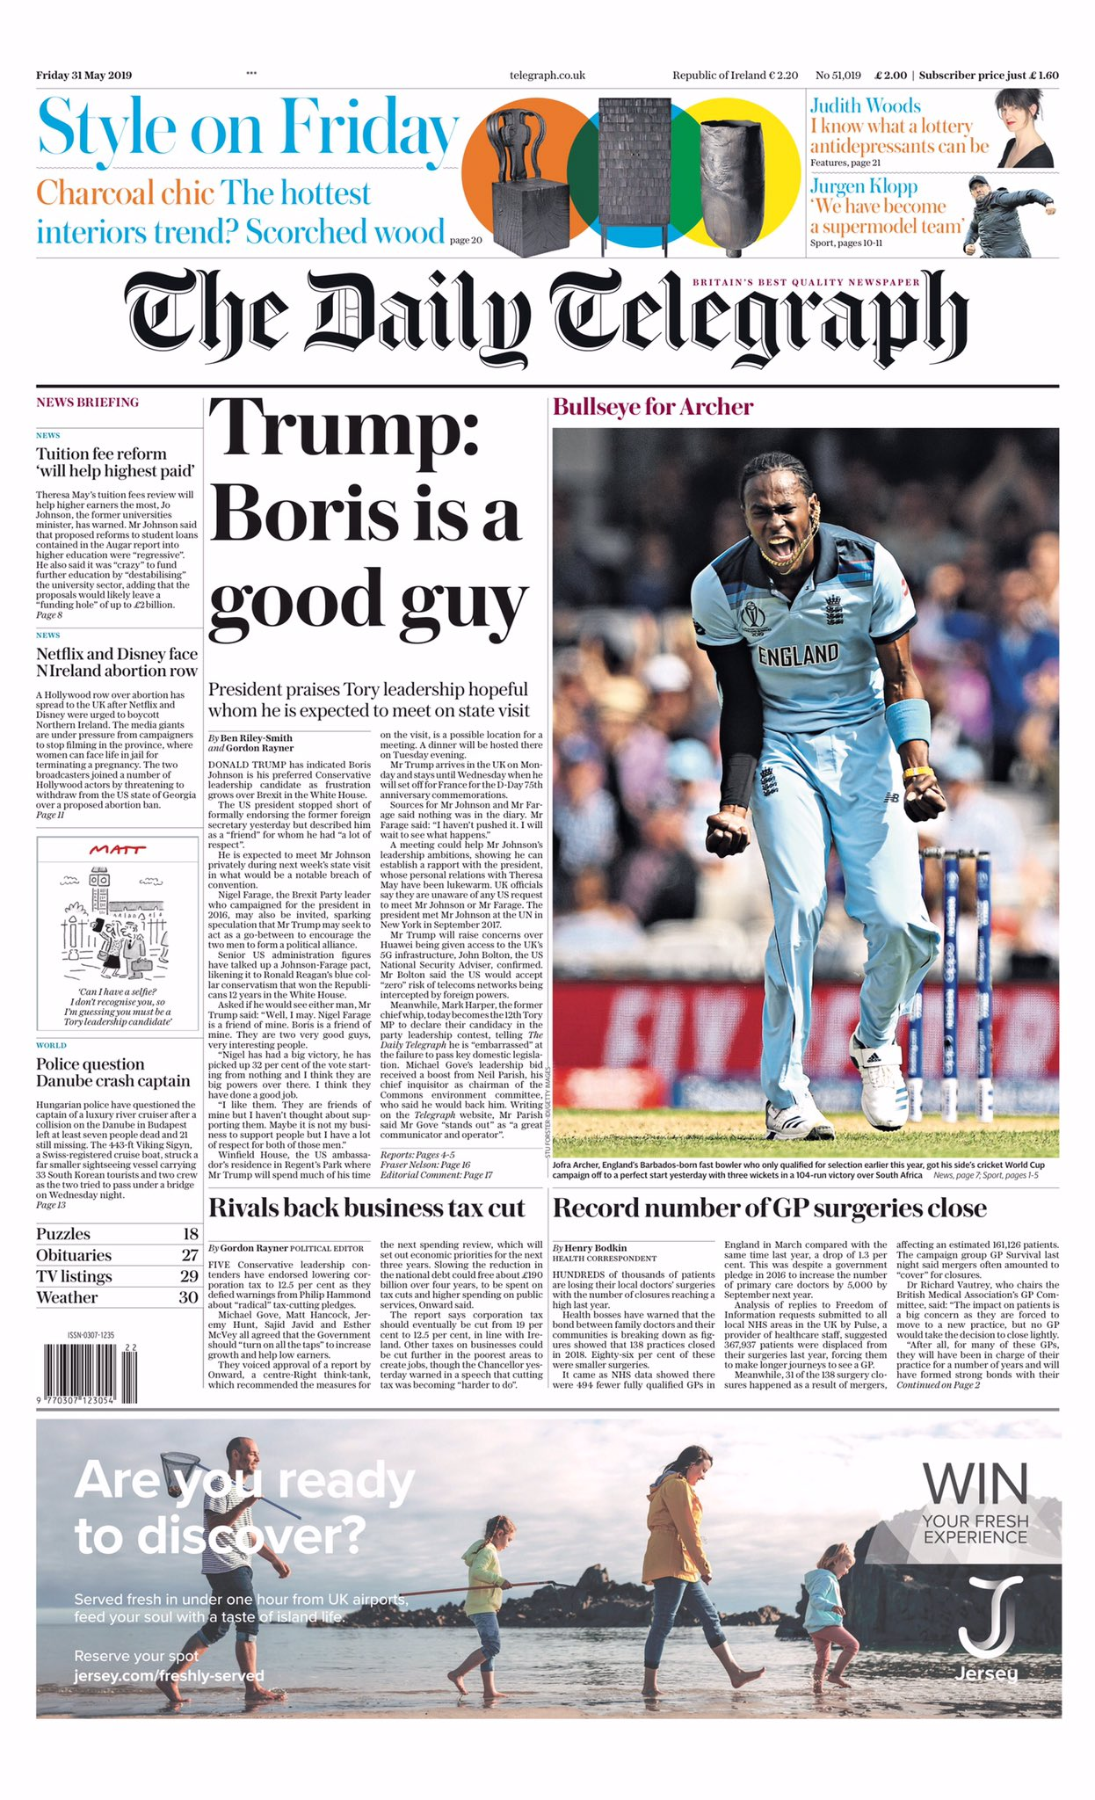

Slide 12
And what we can do for you…
Raise the profile of general practice in the media – hundreds of national media mentions every year
Regularly cited in Parliament – including in Prime Ministers Questions this year
Read by those in power….

Slide 16
jaimiekaffash@cogora.com

